Slide 1

ICE 3161
COMMUNICATION ENGINEERING
Dr. Asif Zaman
Professor, CSE, RU

Slide 2
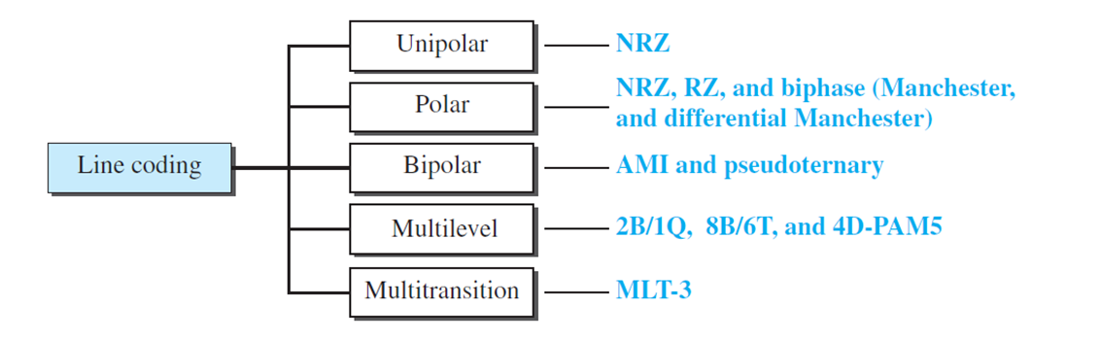
Digital-to-digital Conversion
The conversion involves three techniques:
line coding,
block coding, and
scrambling.

Slide 3
Analog-to-digital Conversion
…is to change an analog signal to digital data.
The most common technique to change an analog signal to digital data (digitization) is called pulse code modulation (PCM).
A PCM encoder has three processes,
The analog signal is sampled.
The sampled signal is quantized.
The quantized values are encoded as streams of bits.

Slide 4
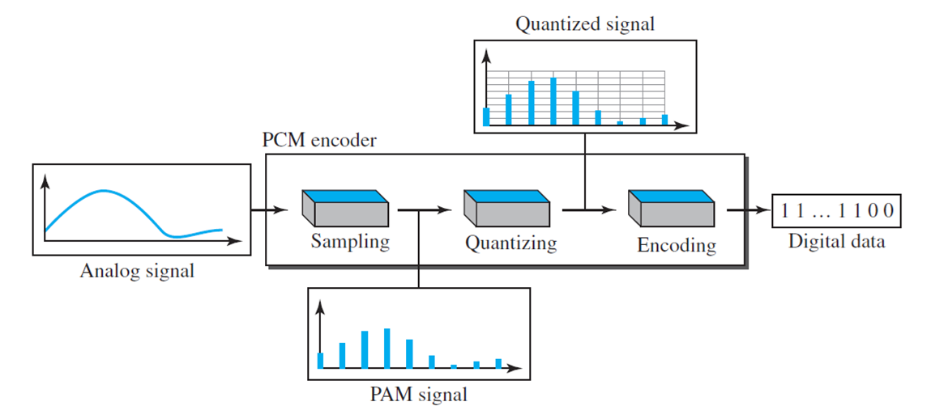
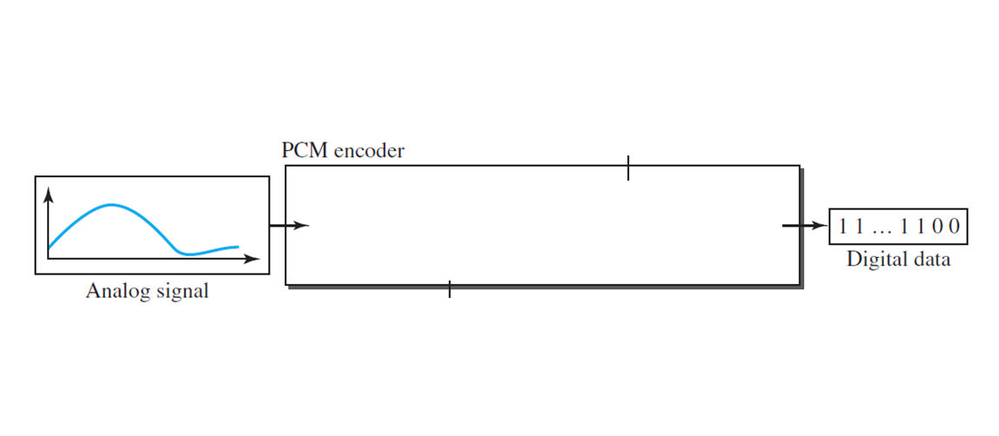
Sampling:
The analog signal is sampled every T_{s} sec,
where T_{s} is the sample interval or period.
The inverse of the sampling interval is called the sampling rate or sampling frequency and denoted by f_{s},
where f_{s} = 1/ T_{s}.

Slide 5
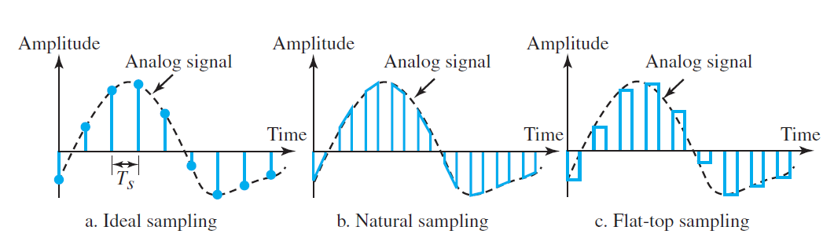
There are three sampling methods—
ideal,
natural, and
flat-top
The sampling process is sometimes referred to as pulse amplitude modulation (PAM).
We need to remember, however, that the result is still an analog signal with Non-integral values.
In ideal sampling, pulses from the analog signal are sampled.
In natural sampling, a high-speed
switch is turned on for only the small period of time when the sampling occurs. The
result is a sequence of samples that retains the shape of the analog signal
sample and hold, however, creates flat-top samples
by using a circuit

Slide 6
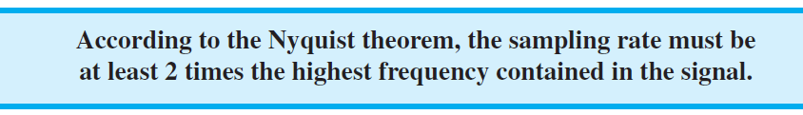
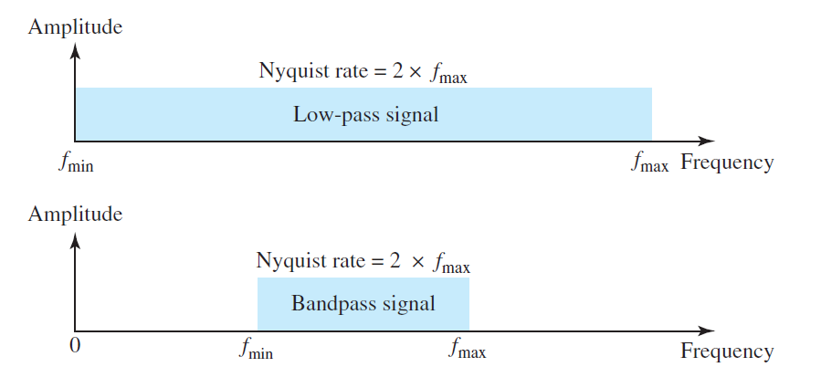
What are the restrictions on T_{s}?
First, a signal with an infinite bandwidth cannot be sampled.
Second, the sampling rate must be at least 2 times the highest frequency, not the bandwidth.

Slide 7
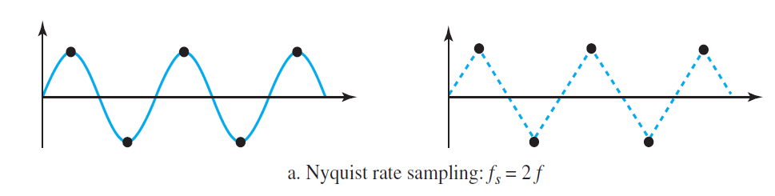
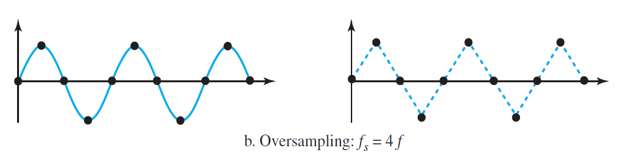
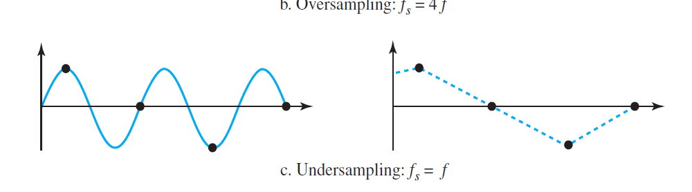

Slide 8
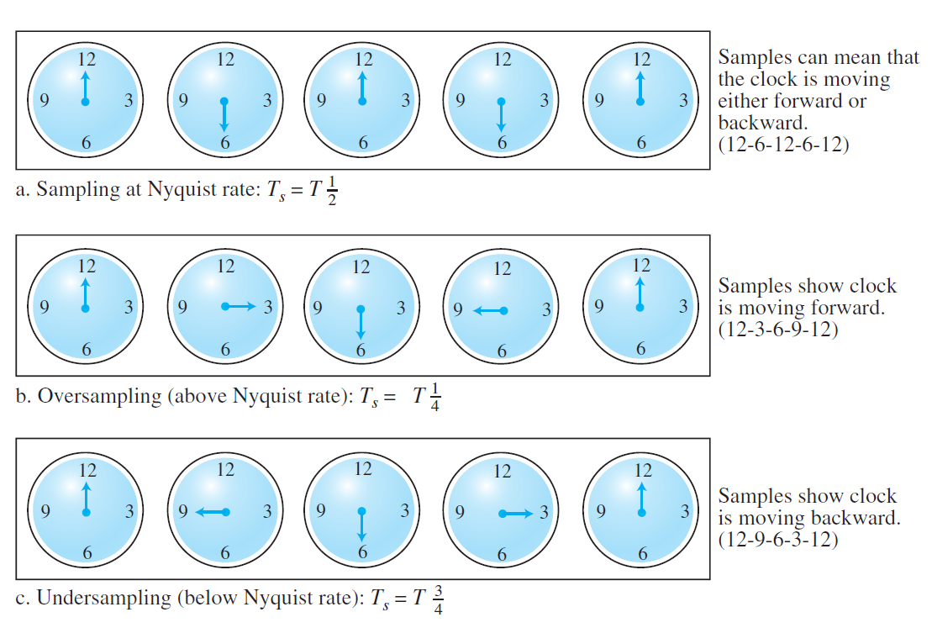
60 sec/cycle

Slide 9
Quantization
The result of sampling is a series of pulses with amplitude values between the maximum and minimum amplitudes of the signal.
The set of amplitudes can be infinite with nonintegral values between the two limits.
These values cannot be used in the encoding process.

Slide 10
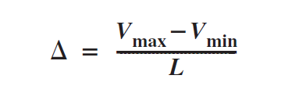
The following are the steps in quantization:
We assume … the original analog signal has … amplitudes between V_{min} and V_{max}.
We divide the range into L zones, each of height Δ (delta).
We assign quantized values of 0 to L − 1 to the midpoint of each zone
We approximate the value of the sample amplitude to the quantized values

Slide 11
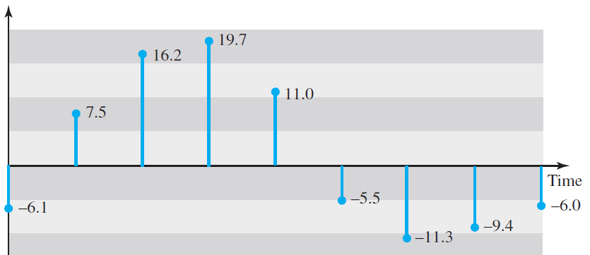
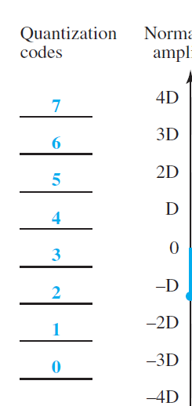
20
15
10
5
0
-5
-10
-15
-20
−20 and +20 V We decide to have eight levels (L = 8). This means that
Δ = 5 V.

Slide 12
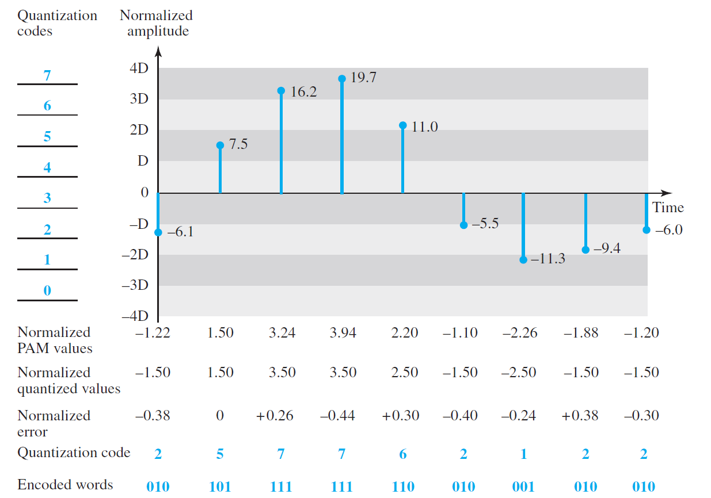

the first row is the normalized value for each sample
(actual amplitude/ Δ ).
$$−\frac{6.1}{5}=−1.22$$
$$\frac{7.5}{5}=1.5$$
Notes:
pulse amplitude modulation (PAM)

Slide 13
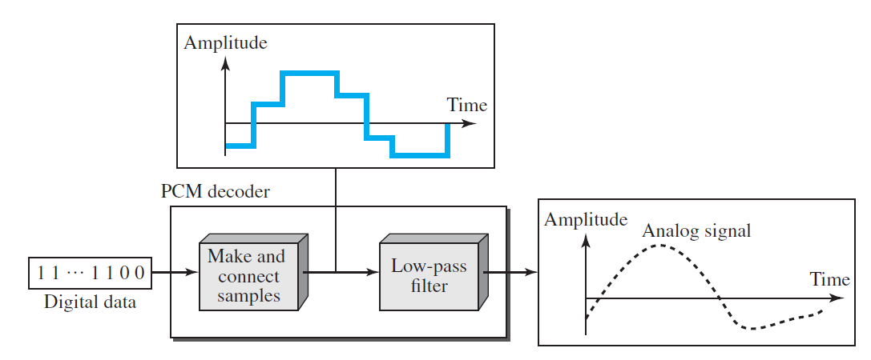
Original Signal Recovery

Slide 14
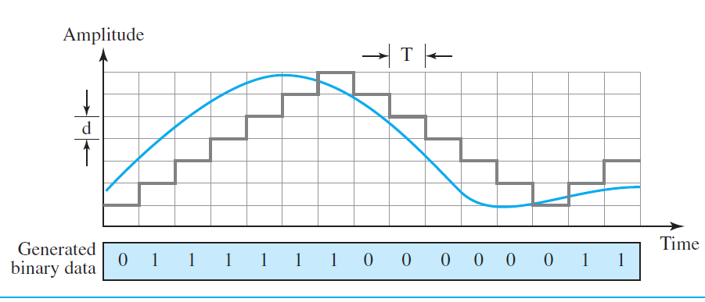
Delta Modulation (DM)
Modulator
The modulator is used at the sender site to create a stream of bits from an analog signal.
The process records the small positive or negative changes, called delta δ.
If the delta is positive, the process records a 1;
if it is negative, the process records a 0.

Slide 15
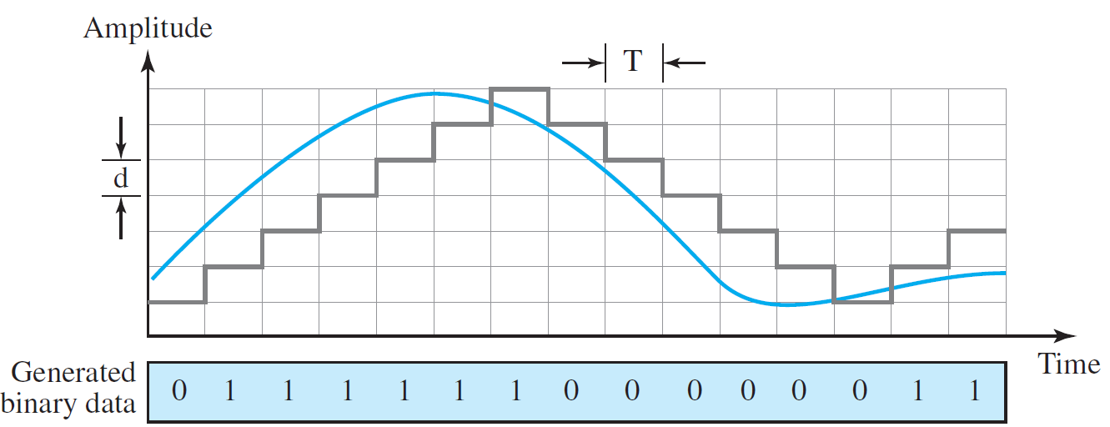
The modulator, at each sampling interval, compares the value of the analog signal
with the last value of the staircase signal.
If the next bit is 1, the staircase maker
moves the last point of the staircase signal δ up; if the next bit is 0, it moves it δ down.
Note that we need a delay unit to hold the staircase function for a period between two comparisons.
If the amplitude of the analog signal is
larger, the next bit in the digital data is 1; otherwise, it is 0.

Slide 16
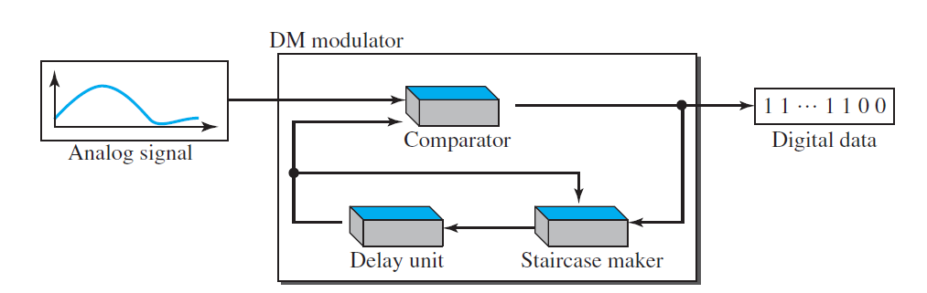
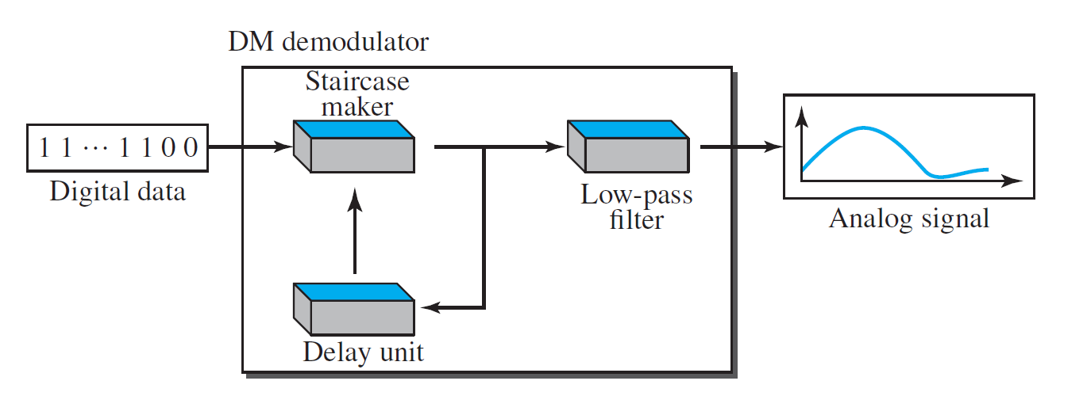
Delta Modulation (DM)

Slide 17
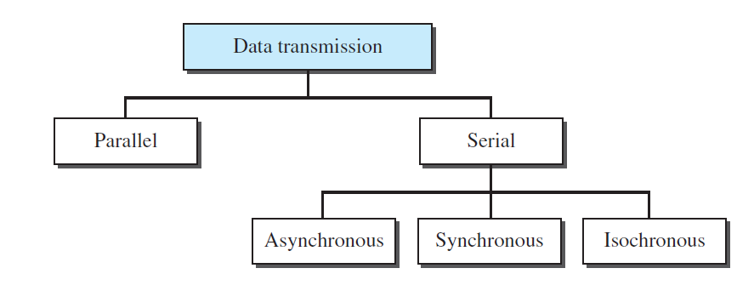
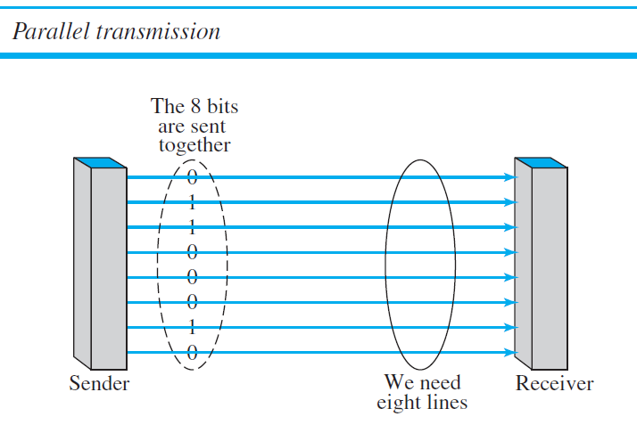
Transmission Modes

Slide 18
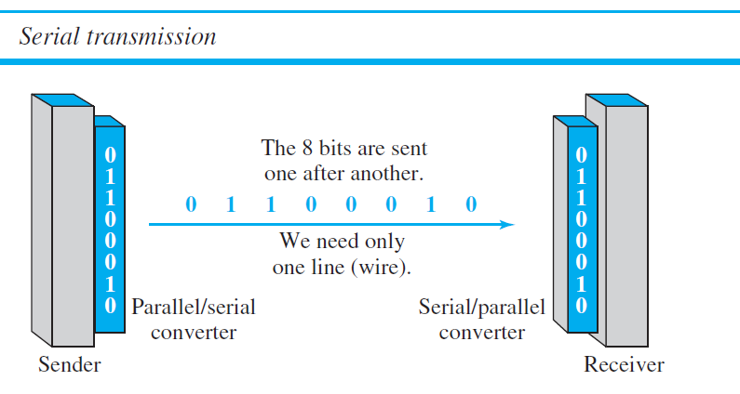

Slide 19
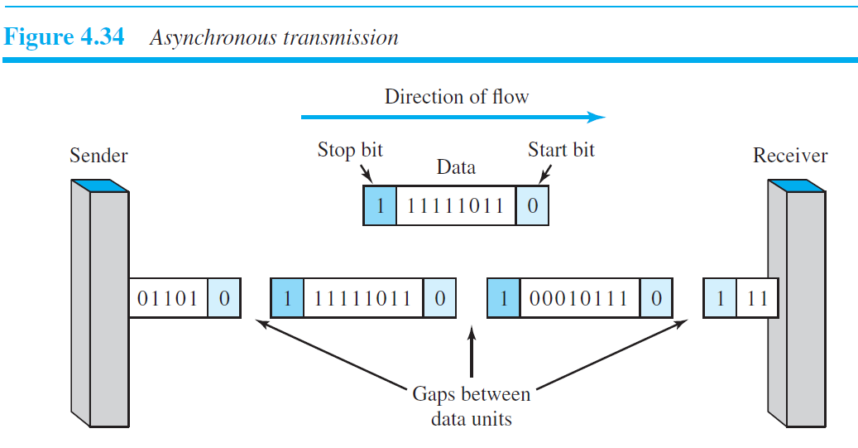
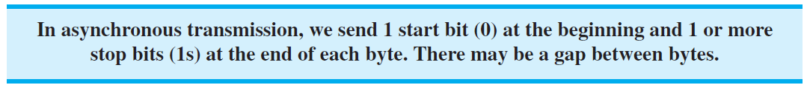
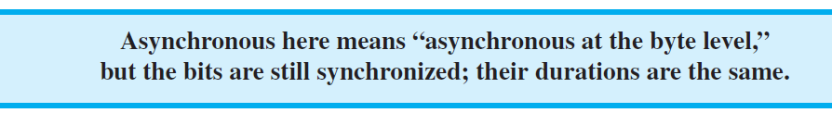
Asynchronous Transmission
Asynchronous transmission is so named because the timing of a signal is unimportant.
Instead, information is received and translated by agreed upon patterns.

Slide 20
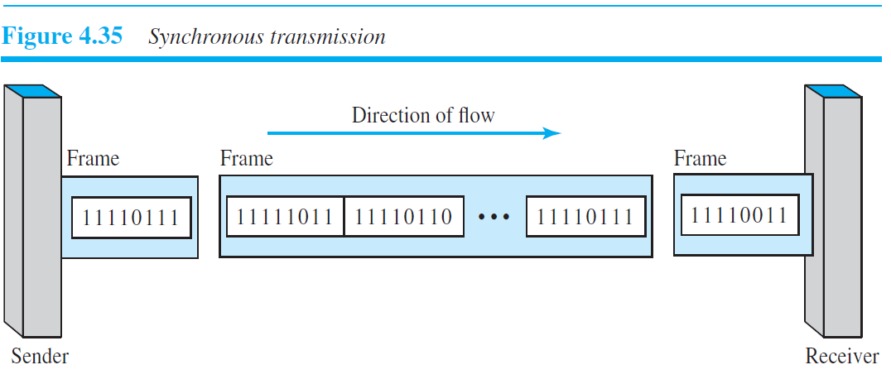
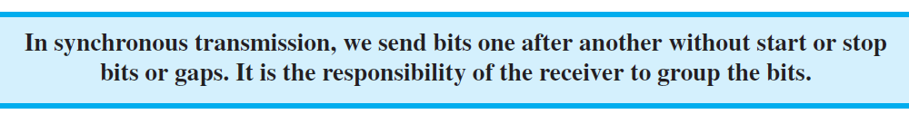
Synchronous Transmission

Slide 21
Isochronous
In real-time audio and video, in which uneven delays between frames are not acceptable, synchronous transmission fails.
The isochronous transmission guarantees that the data arrive at a fixed rate.

